Slide 1

Python Webscraper Project

Slide 2
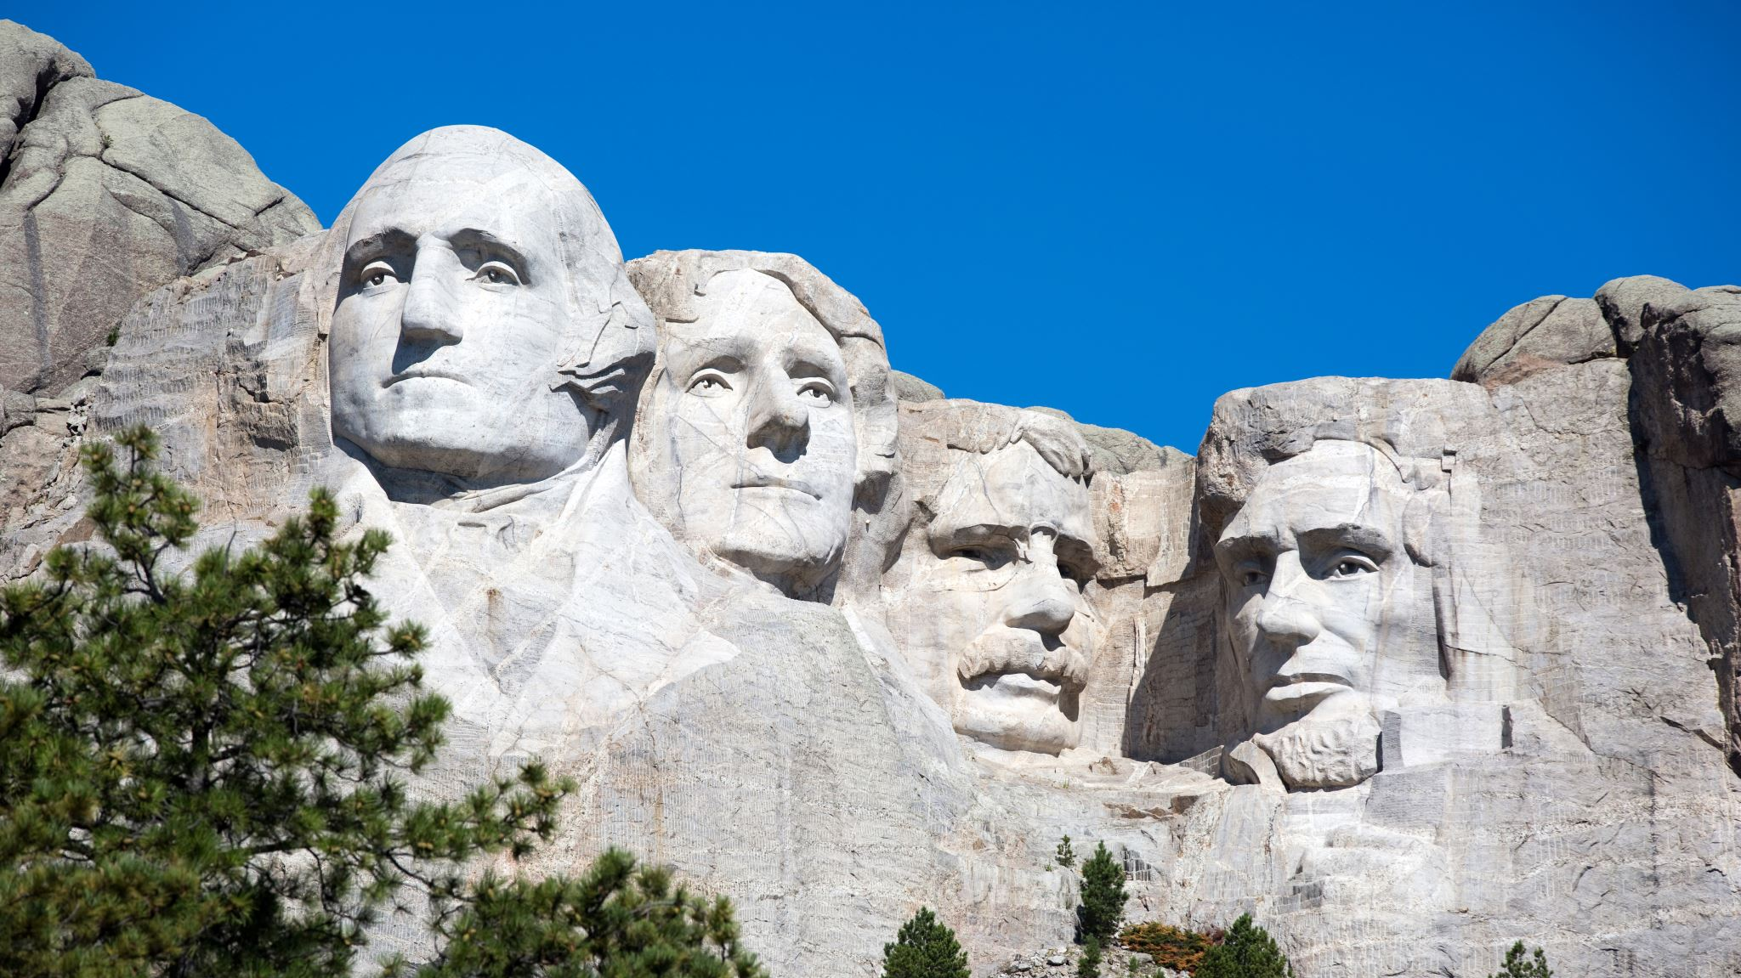
Part 1: US Presidential Biodata

Slide 3
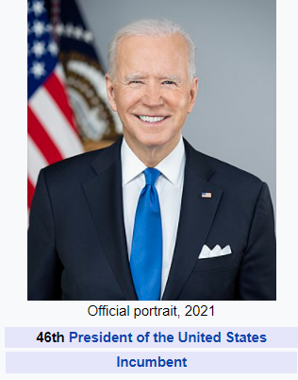
Deliverable 1: CSV Files

Slide 4
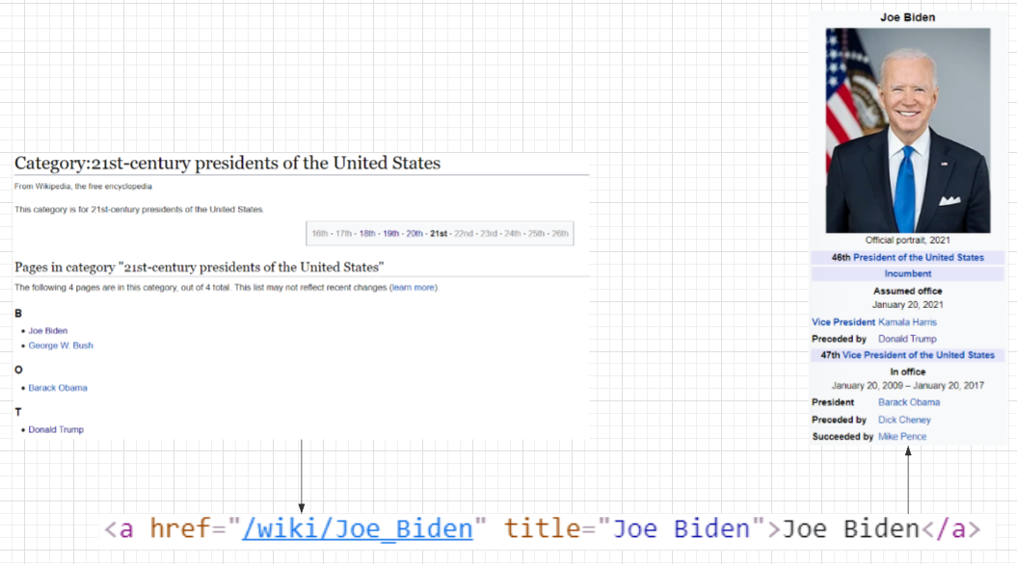
D1

Slide 5



D1

Slide 6
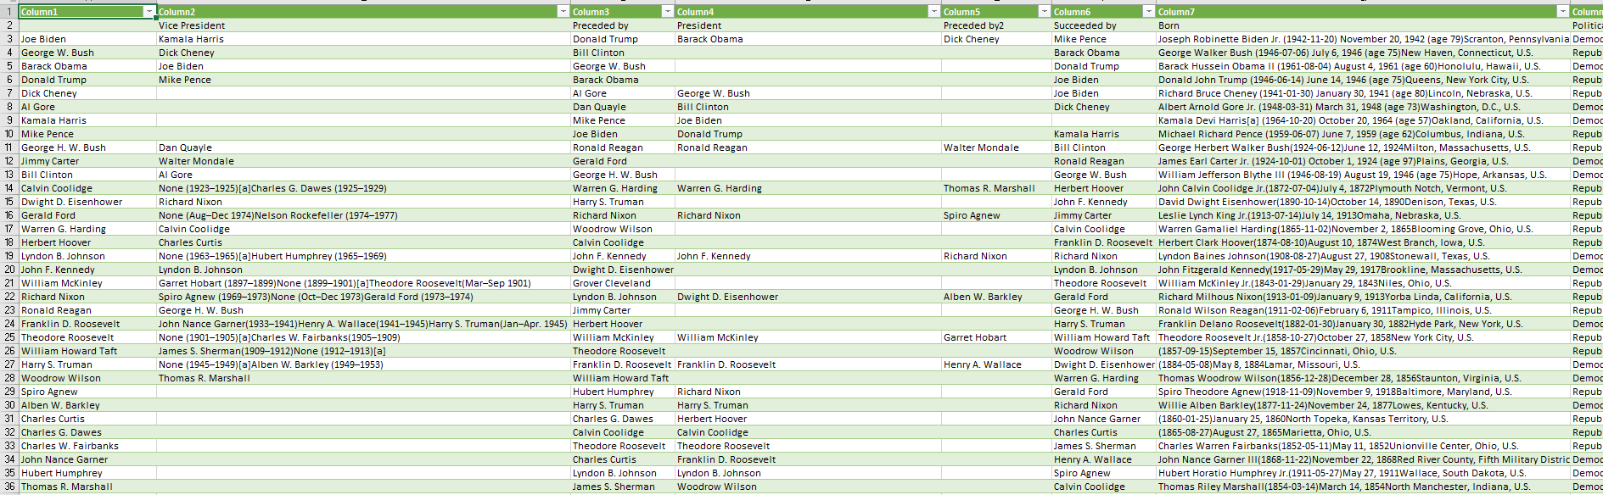
D1

Slide 7

Deliverable 2: Insights

Slide 8
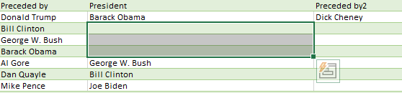
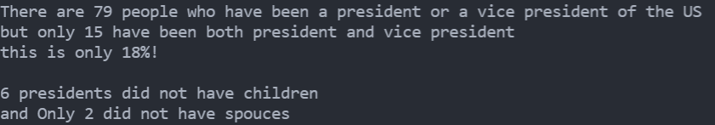
D2

Slide 9

Part 2: Media Sentiment Analysis

Slide 10

Deliverable 3: Politico Article

Slide 11
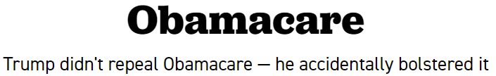
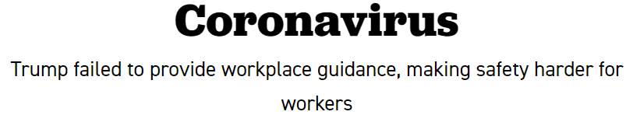
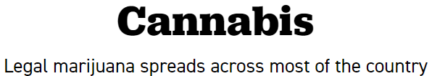
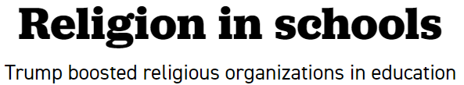
D3

Slide 12

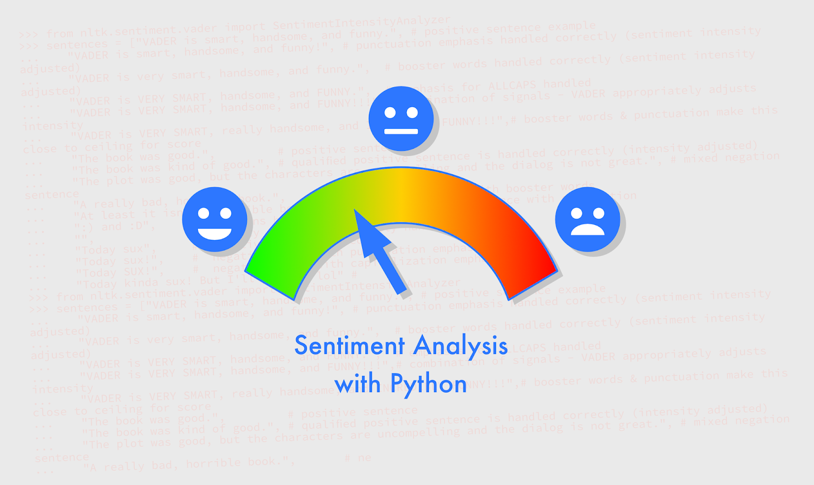
D3

Slide 13
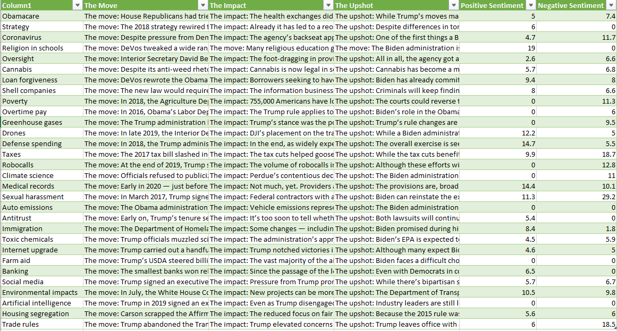
D3

Slide 14
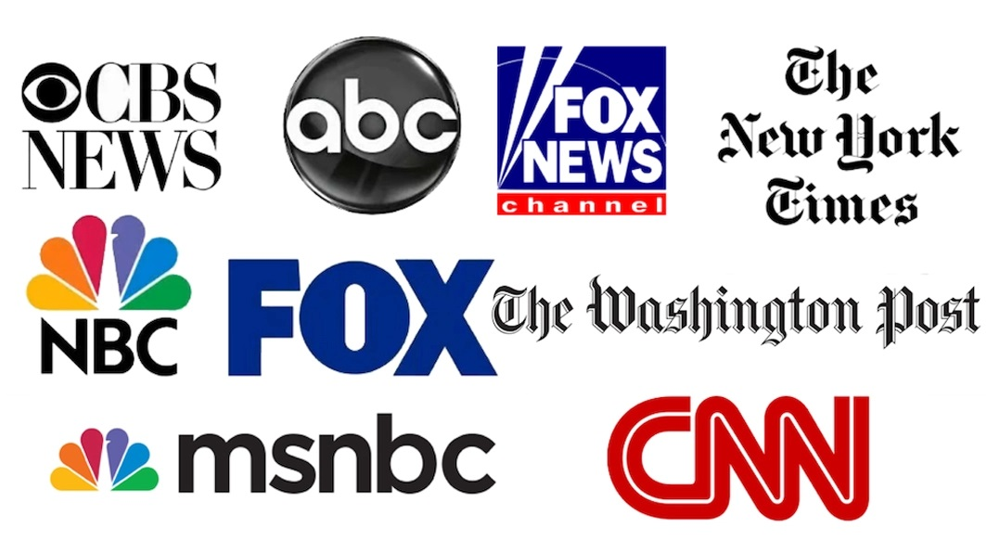
Deliverable 4 + 5: Media Favorability & Heat Map

Slide 15
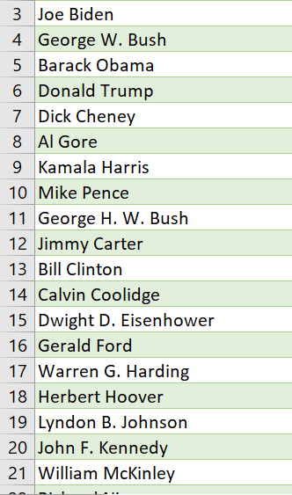
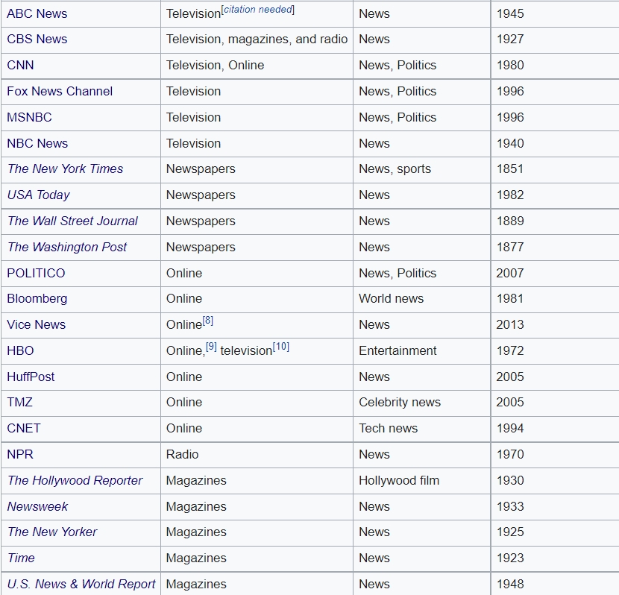
D4+5

Slide 16
D4+5
https://www.usatoday.com/search/?q=

Slide 17
D4+5
https://www.usatoday.com/search/?q=joe+biden

Slide 18
D4+5
https://www.usatoday.com/search/?q=joe+biden
https://www.usatoday.com/search/?q=george+w+bush
https://www.usatoday.com/search/?q=barack+obama
https://www.usatoday.com/search/?q=donald+trump
https://www.usatoday.com/search/?q=dick+cheney
https://www.usatoday.com/search/?q=al+gore
https://www.usatoday.com/search/?q=kamala+harris
https://www.usatoday.com/search/?q=mike+pence

Slide 19
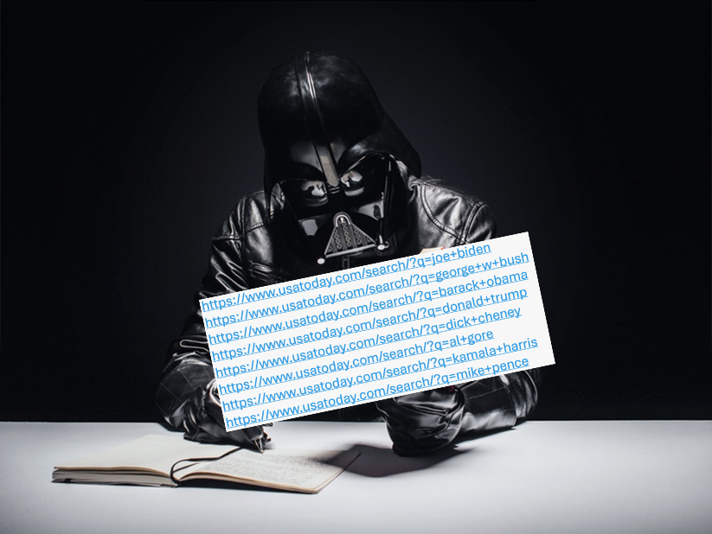
D4+5

Slide 20
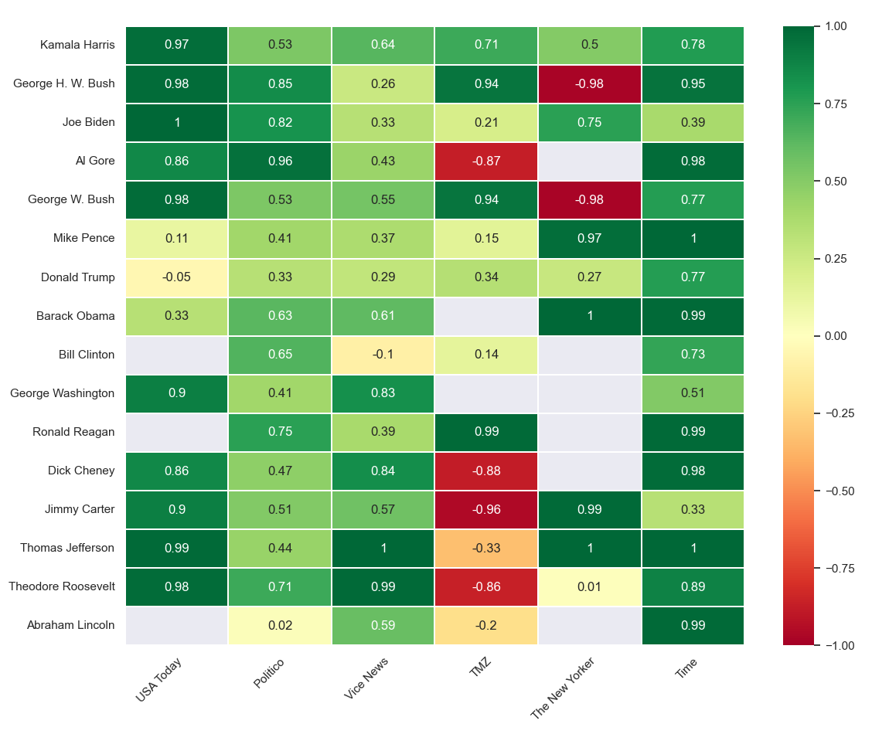
D4+5

